Slide 1

Deductive Logical Reasoning

Slide 2
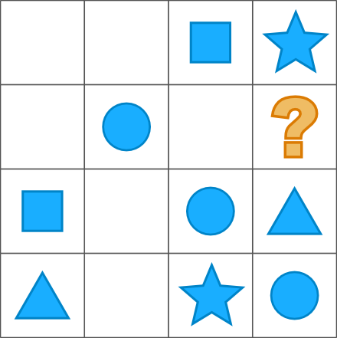




Q. 1
A
B
C
D

Slide 3
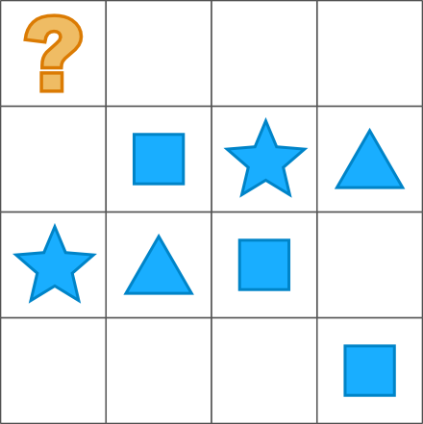
Q. 2
A
B
C
D

Slide 4
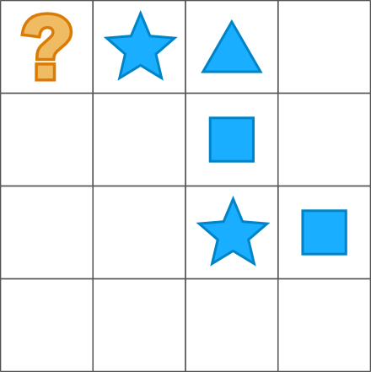
Q. 3
A
B
C
D

Slide 5
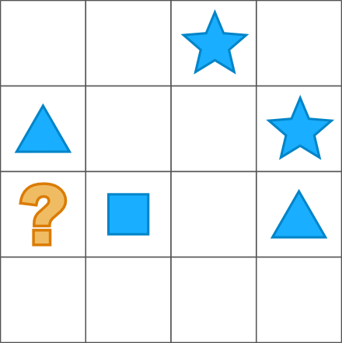
Q. 4
A
B
C
D

Slide 6
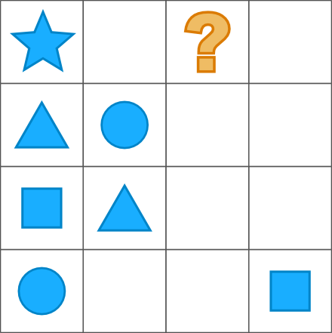
Q. 5
A
B
C
D

Slide 7
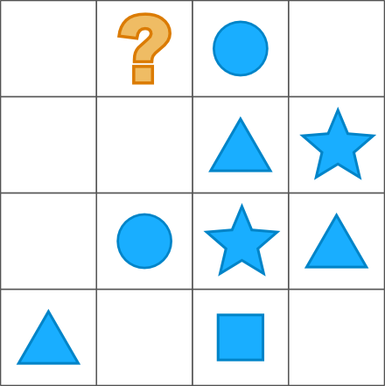
Q. 6
A
B
C
D

Slide 8
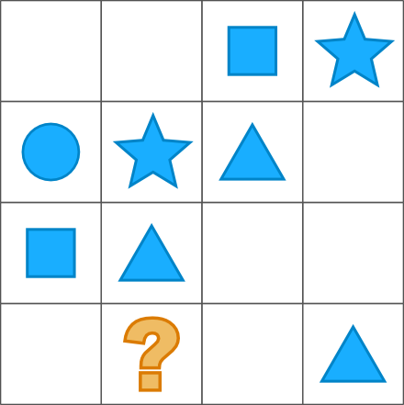
Q. 7
A
B
C
D

Slide 9
Inductive Logical Reasoning

Slide 10
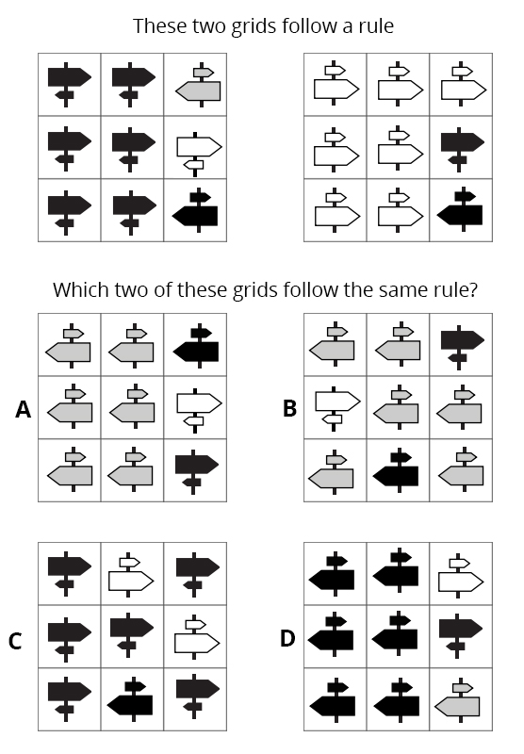
Q. 1

Slide 11
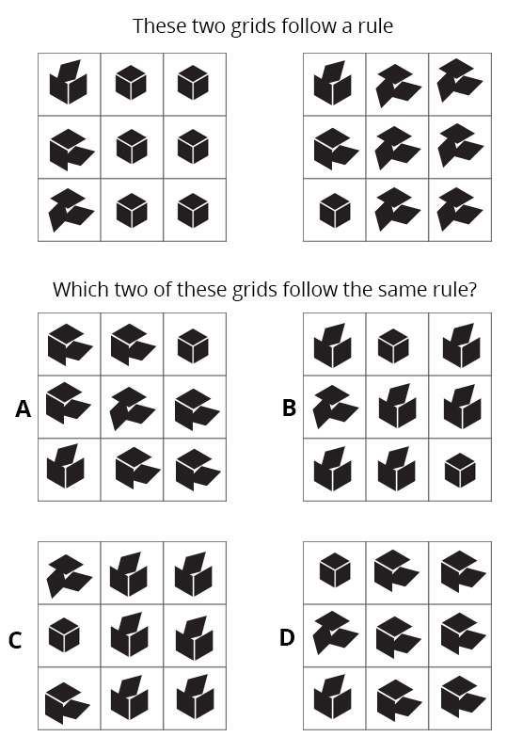
Q. 2

Slide 12
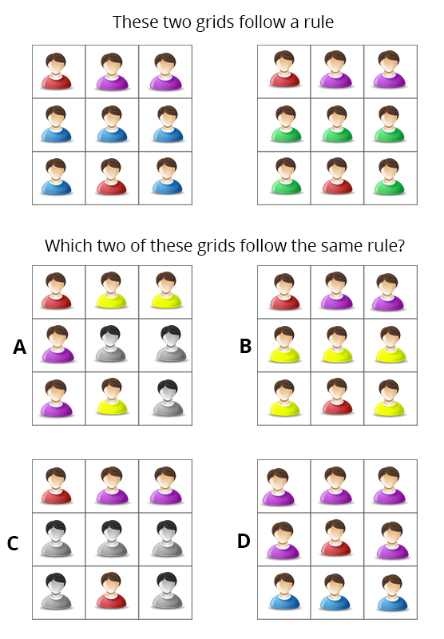
Q. 3

Slide 13
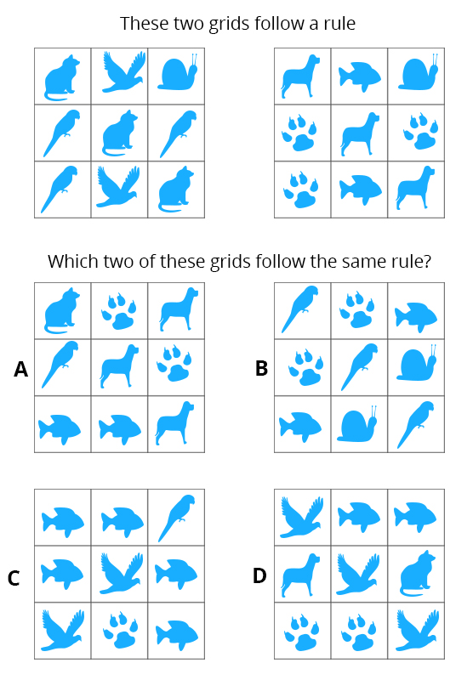
Q.4

Slide 14
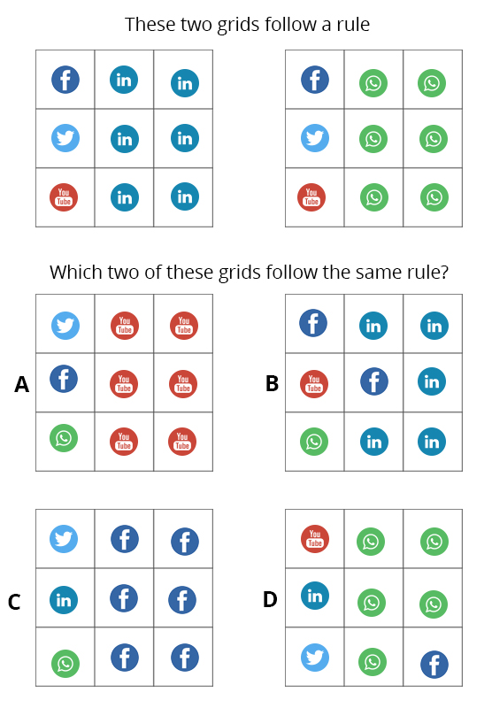
Q. 5

Slide 15
Thank You…!

